Slide 1

Creating Packages
By
Krishnaprakash N
GBS IT Innovation Quality

Slide 2
Using the EXECUTE IMMEDIATE Statement
Use the EXECUTE IMMEDIATE Statement for native dynamic SQL with better performance
INTO is used for single-row queries and specifies the variable or records into which column values are retrieved
Using is used to hold all bind arguments. The default parameter mode is IN.

Slide 3
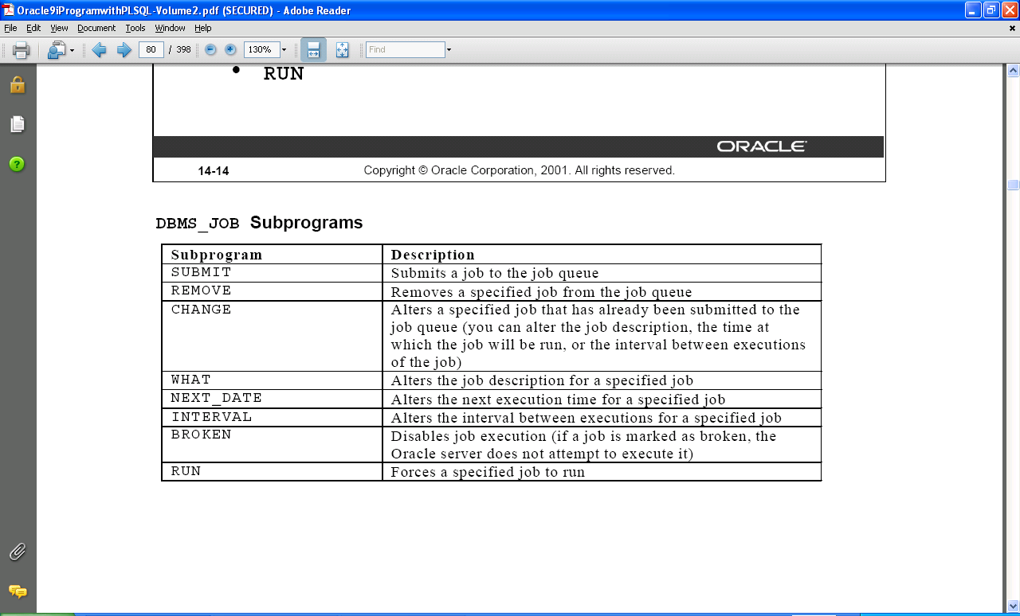
DBMS_JOB Programs

Slide 4
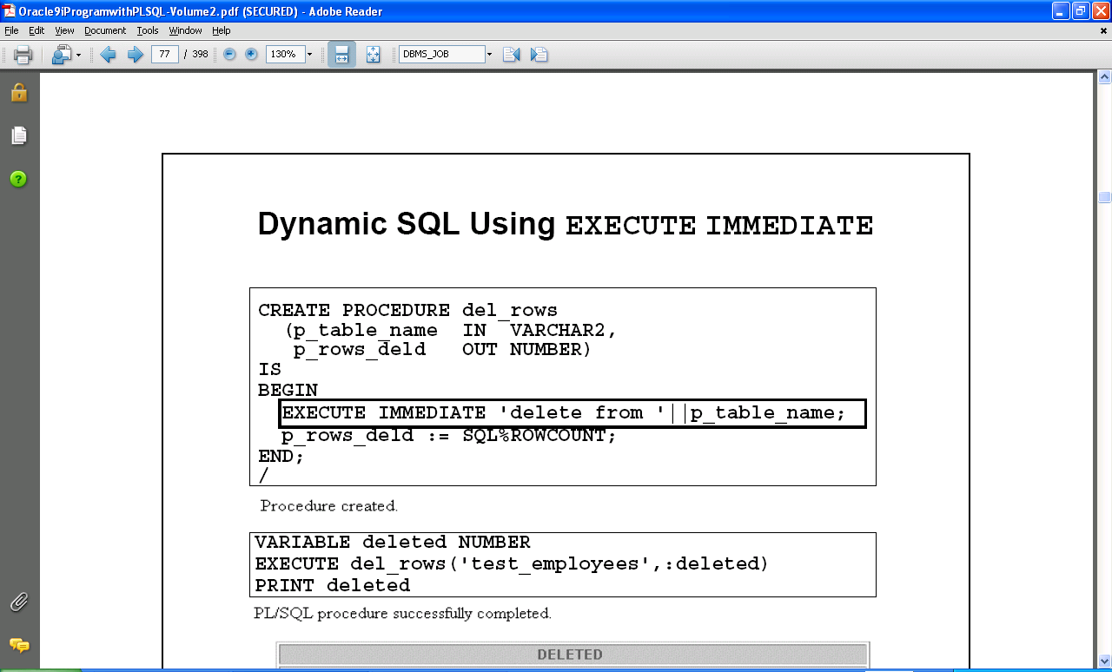
Dynamic SQL Using EXECUTE IMMEDIATE

Slide 5
Using DBMS_JOB for Scheduling
DBMS_JOB Enables the scheduling and execution of PL/SQL programs:
Submitting jobs
Executing jobs
Changing execution parameters of jobs
Removing jobs
Suspending Jobs

Slide 6
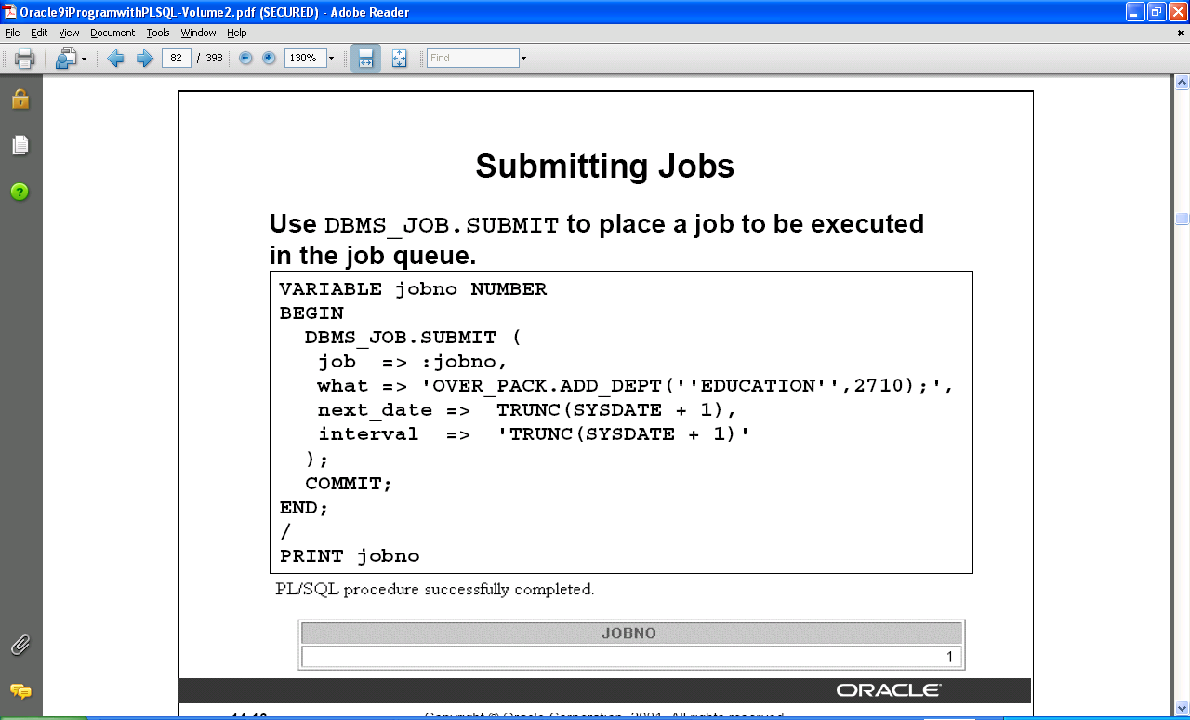
Submitting Jobs

Slide 7
Viewing Information on Submitted Jobs
Use the DBA_JOBS dictionary view to see the status of submitted jobs
SELECT job, Next_date , what
FROM DBA_JOBS;
Use the DBA_JOBS_RUNNING dictionary view to display jobs that are currently running.

Slide 8
What Is the UTL_FILE Package?
Extends I/O to text files within PL/SQL
Provides security for directories on the server through the init.ora file
Is similar to standard operating system I/O
Open files
Get text
Put text
Close files
Use the exceptions specific to the UTL_FILE package

Slide 9
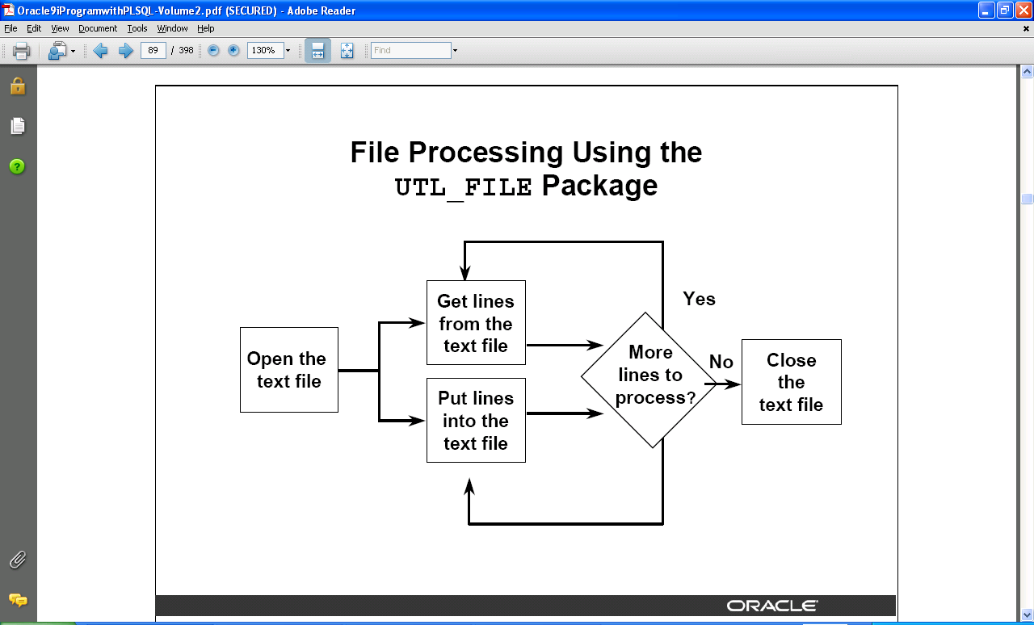
File Processing Using the UTL_FILE Package

Slide 10
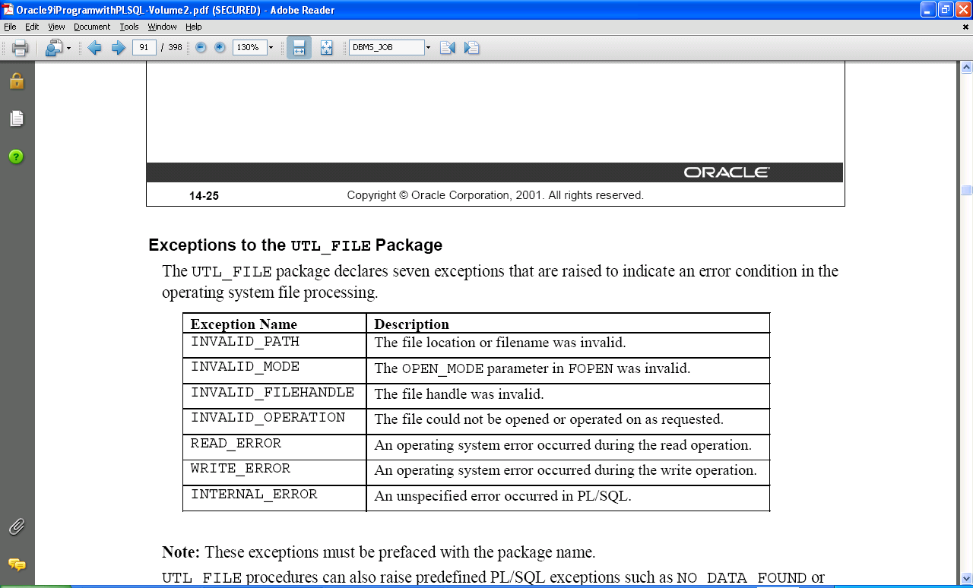
Exceptions Specific to the UTL_FILE Package

Slide 11
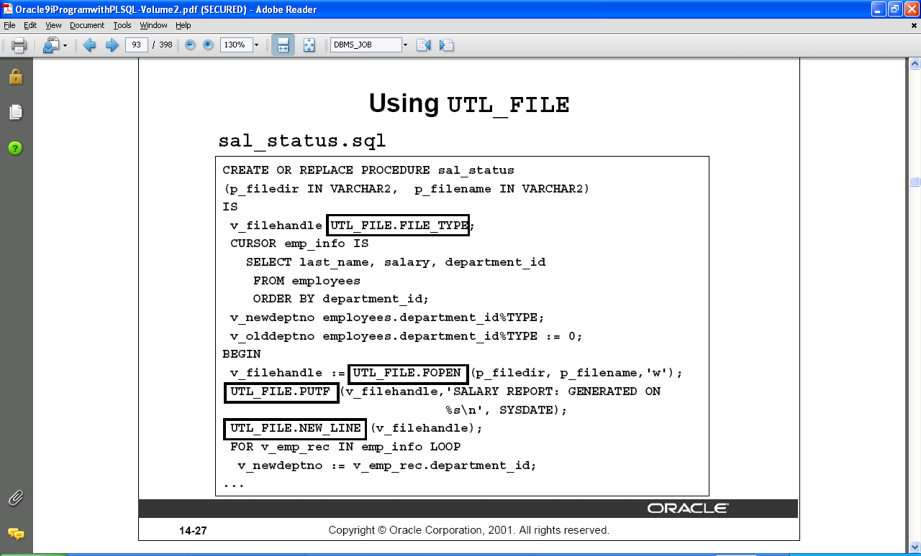
Using UTL_FILE

Slide 12
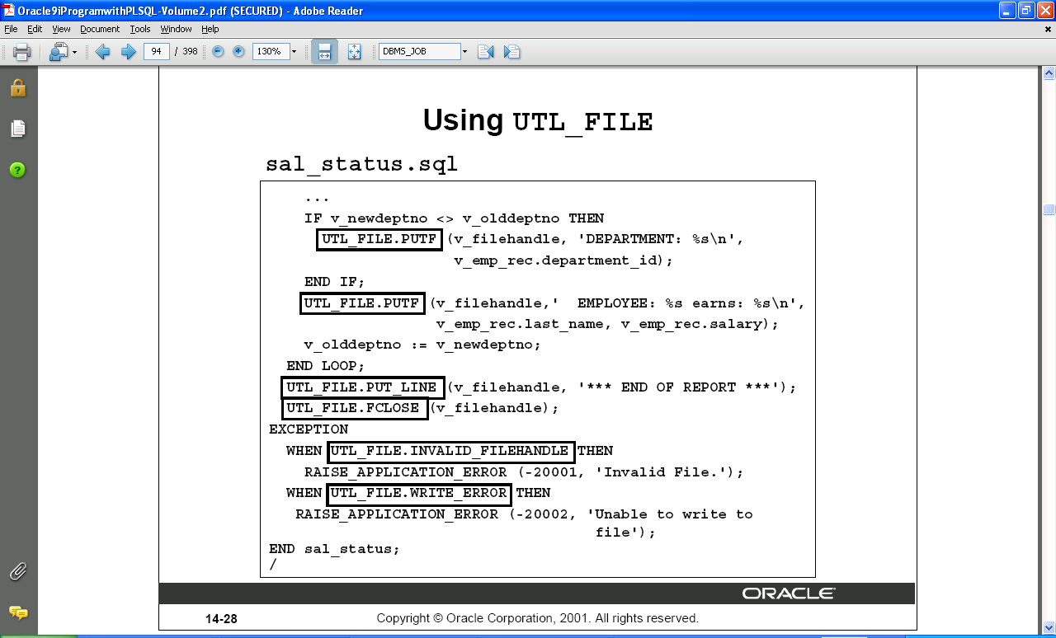
Using UTL_FILE

Slide 13
Thank You

